Slide 1






directions in language evolution research
#NewDirLangEvo
Introduction to the theme session
Stefan Hartmann¹, Jonas Nölle², Peeter Tinits³
¹German Department, University of Bamberg ²Centre for Language Evolution, University of Edinburgh ³University of Tallinn
SLE 2018 - 51st Annual Meeting of the Societas Linguistica Europaea, Tallinn, Estonia

Slide 2
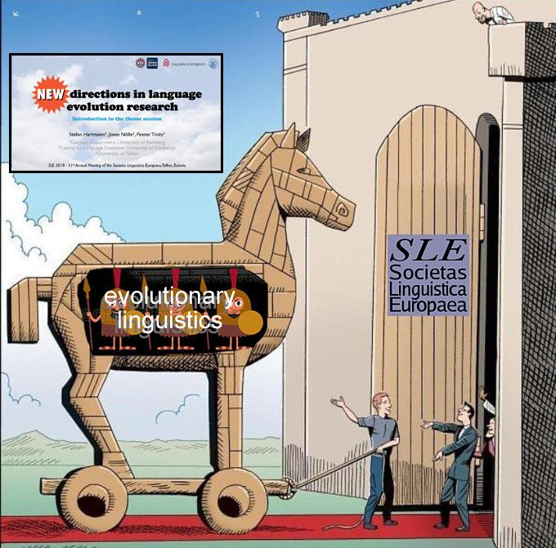

Slide 3
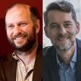
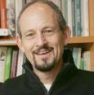
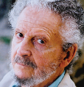
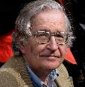
What we mean by ‘language evolution’
“The hardest problem in science”
Kirby & Christiansen (2002)
“A mystery”
Hauser et al. (2014)
“An embarrassment to evolutionary theory”
Premack (1986)
burgeoning literature, most of which in my view is total nonsense.”
Chomsky (2011)
Notes:
Since this is the first lang evo workshop in the (recent) history of SLE (that we can trace back), we’d like to give a short introduction into what we actually understand of

Slide 4

Why do we speak (while animals don’t) ?
Where do languages come from?
Notes:
It’s prob. safe to assume that from the point where humans could speak and think in words onwards, they began to wonder how they came to be doing so in the first place! And why there are different languages

Slide 5
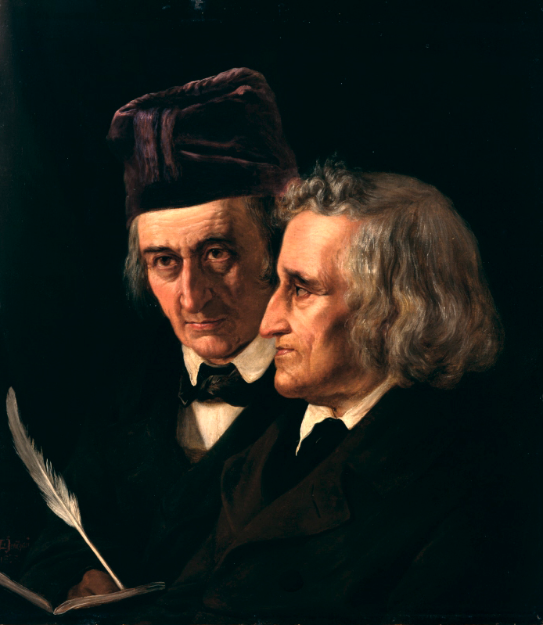

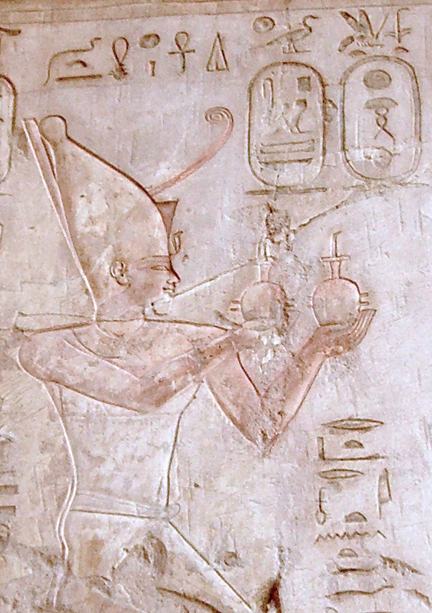
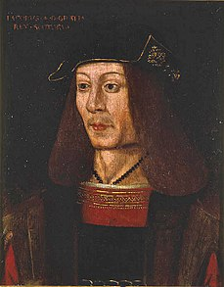
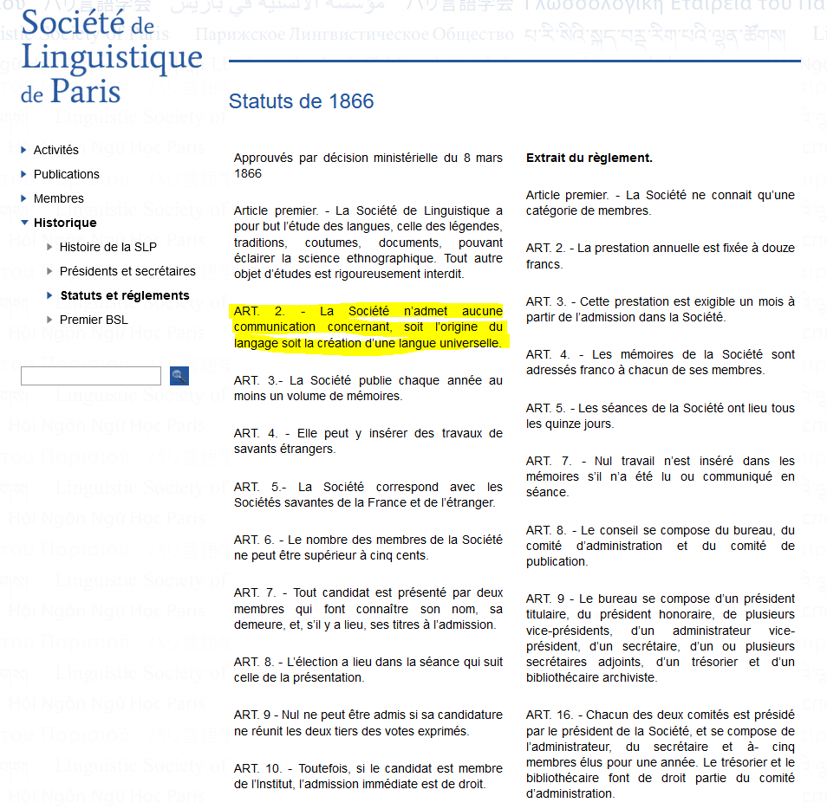
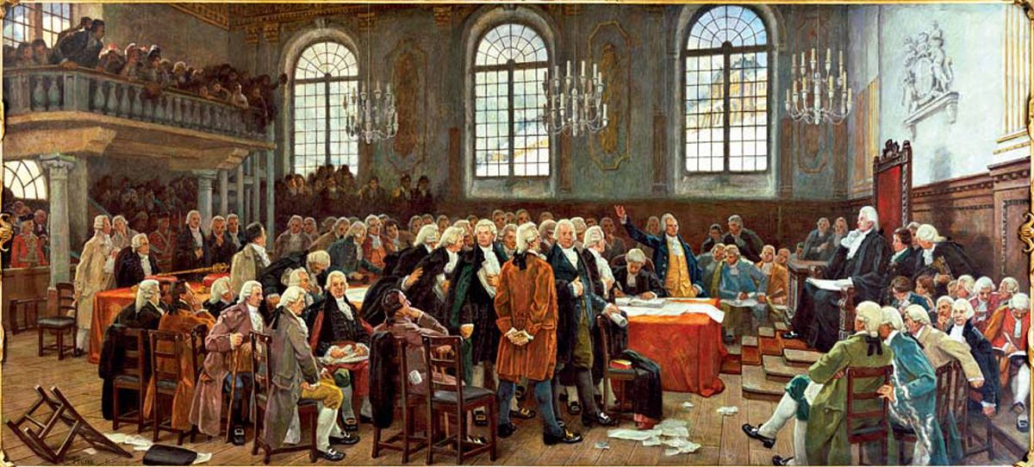
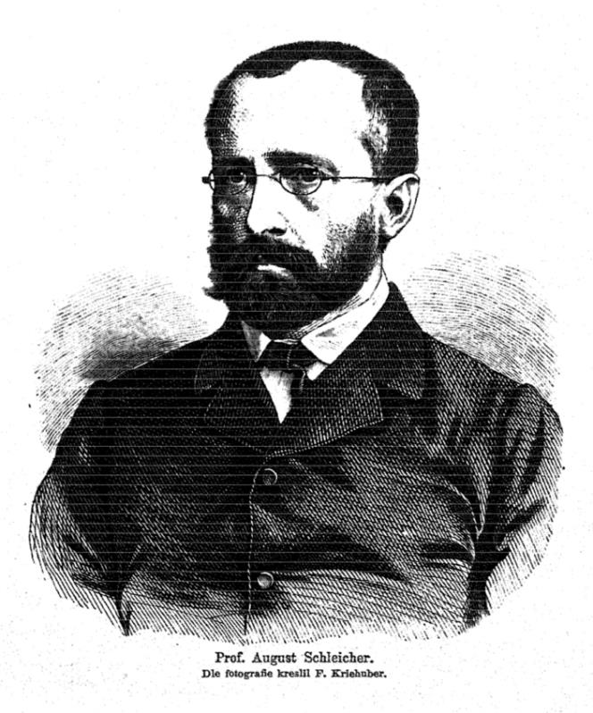
The ‘Dark Age’ of LE research
“The survival of certain favoured words in the struggle for existence is natural selection” (Descent 1: 61).
Notes:
Lots of early “scholars” were interested in the origin of language, or whether there was is a “true language”: babel tower story in bible, language-deprivation experiments by Pharao Psamtik I and Scottish King Goerge IV (long before the Edinburgh school was founded! ;-) ) among others - which usually didn’t end well; Brothers Grimm were among the first to highlight the genealogical relatedness of languages and paved the way for historical linguistics and study of cultural evolution; early lang evo speculation famously culminated in the Paris Society ban of 1866 (which they kindly left online on their website since then ;-) )
→ however over time ppl took it seriously again focusing on the same set of questions that was already present here: origin of language as a capacity, and the evolution of actual languages

Slide 6
…

Slide 7
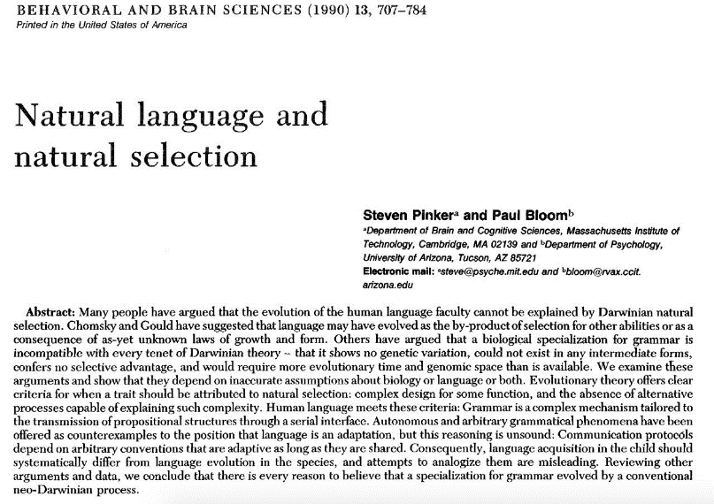
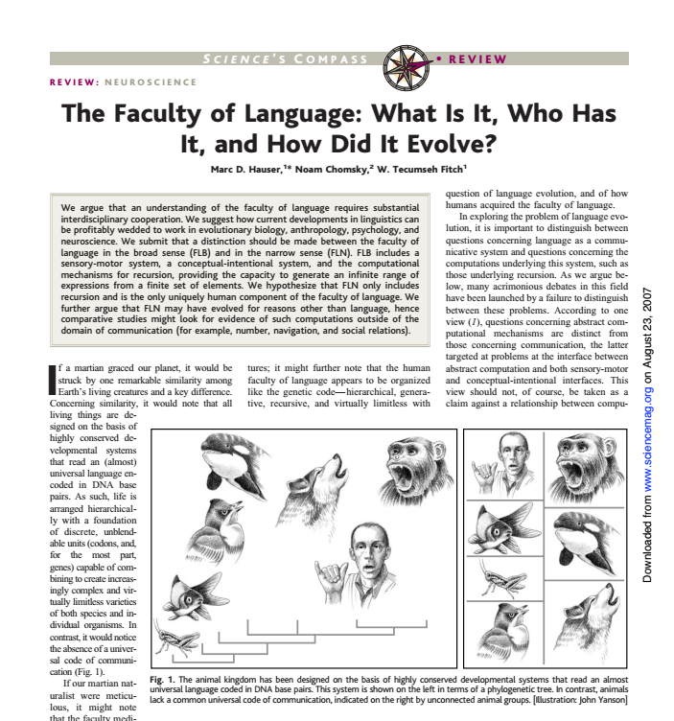
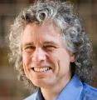
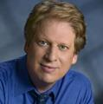
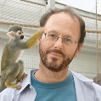
The ‘Coming-of Age’ of LE research
evolutionary ling. vs boiling emerged
established conferences, show pics of evolang and protolang and:
various paradigms and subfields emerged from this
… → next slide
Notes:
“Modern” lang evo research is often said to have started in the 90’s with Pinker & Bloom on the one side and the ‘Edinburgh school’ being founded by Jim Hurford (who sadly recently retired from the CLE) on the other side
The field then slightly diverged, by having people focus on the biological side in the spirit of P&B on the one side (defining FLN and FLB), and others focus on the ‘cultural’ side, such as Simon Kirby and colleagues, who developed the iterated learning model
While there were heated debates over the role of innateness and culture in the origins of language, the field has since matured into a serious scientific endeavour that remains critical but fosters inter-disciplinary and trans-disciplinary dialogue and holds regular conferences, and even within LE research subfields emerged that focus on specific questions or methods: MOST importantly, however, the age of speculation has ended, and we are now in age were things are assessed empirically

Slide 8
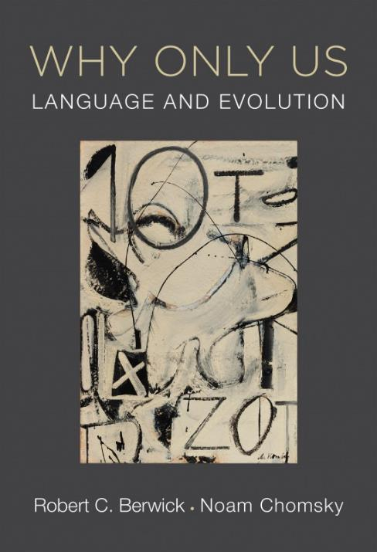
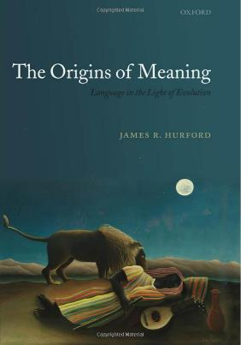
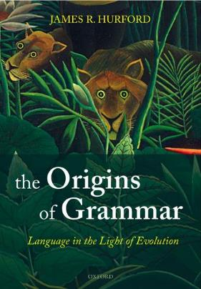
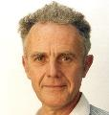

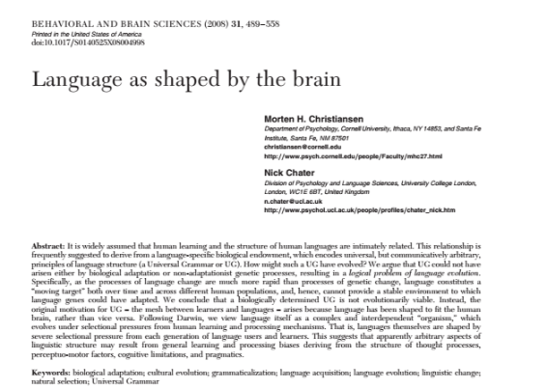

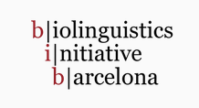


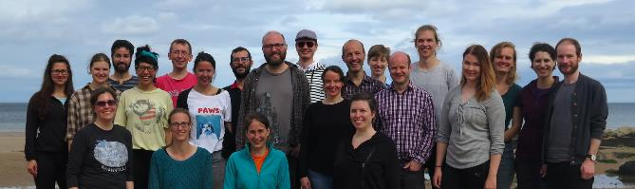

The ‘Coming-of Age’ of LE research
‘Biolinguistics’
‘Evolutionary linguistics’
Notes:
“Modern” lang evo research is often said to have started in the 90’s with Pinker & Bloom on the one side and the ‘Edinburgh school’ being founded by Jim Hurford (who sadly recently retired from the CLE) on the other side
The field then slightly diverged, by having people focus on the biological side in the spirit of P&B on the one side (defining FLN and FLB), and others focus on the ‘cultural’ side, such as Simon Kirby and colleagues, who developed the iterated learning model
While there were heated debates over the role of innateness and culture in the origins of language, the field has since matured into a serious scientific endeavour that remains critical but fosters inter-disciplinary and trans-disciplinary dialogue and holds regular conferences, and even within LE research subfields emerged that focus on specific questions or methods: MOST importantly, however, the age of speculation has ended, and we are now in age were things are assessed empirically

Slide 9

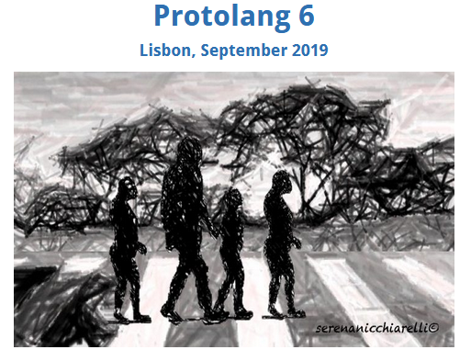
The ‘Coming-of Age’ of LE research
(Next Evolang: 2020 in Brussels)
(Distinguished scholars at the 2018 SLE workshop)
evolutionary ling. vs boiling emerged
established conferences, show pics of evolang and protolang and:
various paradigms and subfields emerged from this
… → next slide
Notes:
“Modern” lang evo research is often said to have started in the 90’s with Pinker & Bloom on the one side and the ‘Edinburgh school’ being founded by Jim Hurford (who sadly recently retired from the CLE) on the other side
The field then slightly diverged, by having people focus on the biological side in the spirit of P&B on the one side (defining FLN and FLB), and others focus on the ‘cultural’ side, such as Simon Kirby and colleagues, who developed the iterated learning model
While there were heated debates over the role of innateness and culture in the origins of language, the field has since matured into a serious scientific endeavour that remains critical but fosters inter-disciplinary and trans-disciplinary dialogue and holds regular conferences, and even within LE research subfields emerged that focus on specific questions or methods: MOST importantly, however, the age of speculation has ended, and we are now in age were things are assessed empirically

Slide 10
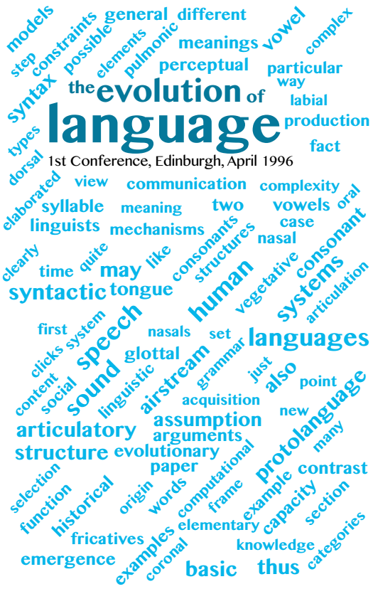
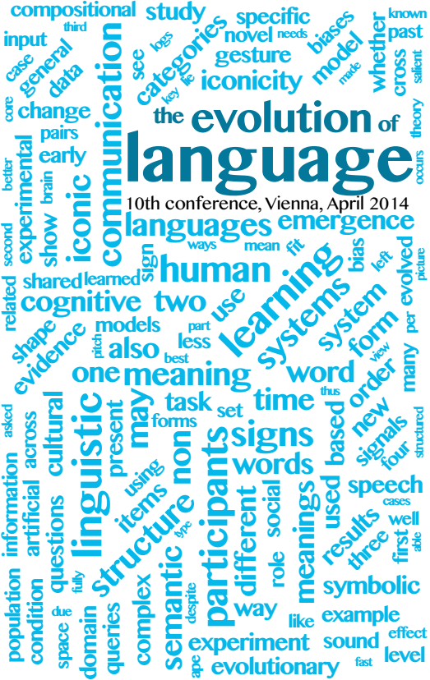
Notes:
Vienna conference: lang evo not only origin and biology but also language dynamics and change (e.g. workshop on connecting historical and evolutionary linguistics, or another one on agent-based model approaches to grammaticalization

Slide 11
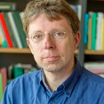
What do we mean by language evolution
Haspelmath (2016)
"Thus, we now have three senses of the term “evolution” in the context of the study of languages:
(1) origin of language as a human-specific trait (Pinker & Bloom, and also most of McMahon & McMahon 2012)
­(2) language change studied from the perspective of variation and selection (Croft 2000, etc.)
(3) language patterns and language change at a global level (Everett et al. and related work)
And this does not even include grammaticalization (Bybee et al. 1994)."
Notes:
grammaticalization researchers also look at pressures and mechanisms
How do this various senses relate to each other?

Slide 12
Methods for studying Language Evolution

Slide 13
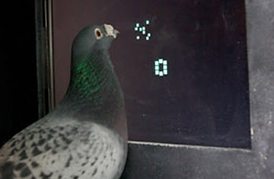
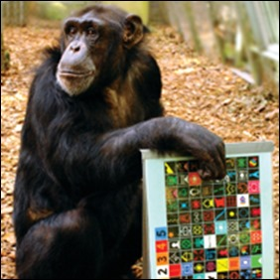
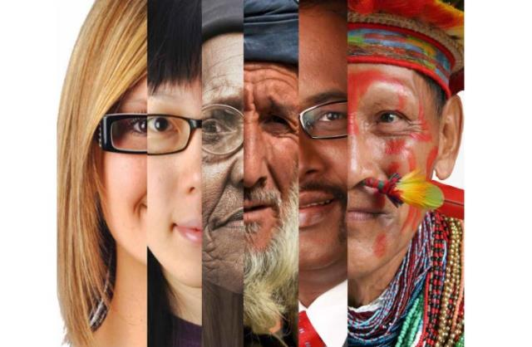
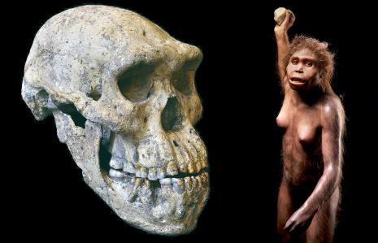
Methods and approaches
“Empirical approaches to the study of language evolution” (Fitch 2017 Psychon Bull Rev):
Comparative cognition/biology
Neuroscientific data
paleontological data
genetic and paleogenetic data
comparative genomics
comparing human populations
Notes:
pathways, genetic/paleo: gene sequences and, allele freqs, long and short time-scales (living human populations)

Slide 14
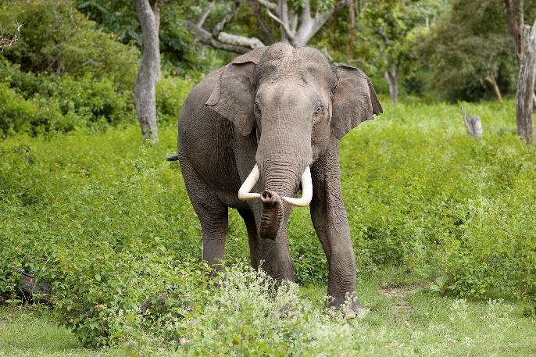
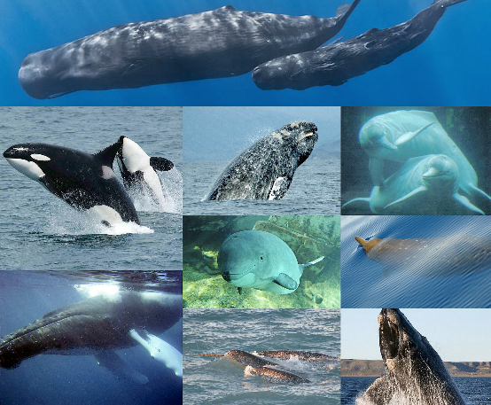
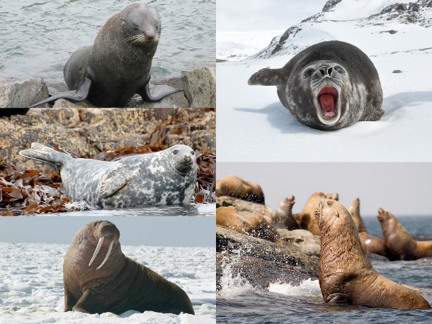
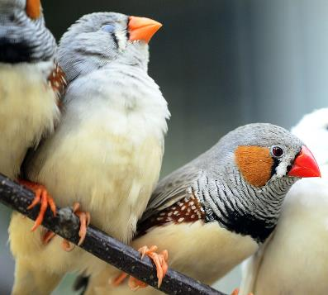
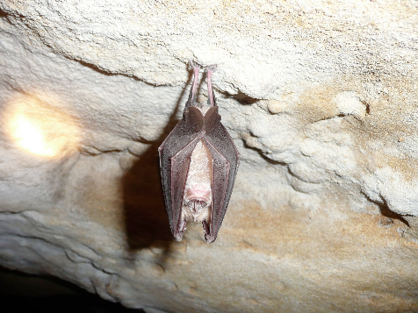
Vocal learning in other species
Bolhuis et al. 2010 Nat Rev Neurosci
Janik 2014 Curr Opin Neurobiol
Ravignani 2016 Front Neurosci
Vernes 2017 Psych Bull Rev
Notes:
To date, vocal learning has been documented in some cetacean, pinniped, elephant, bat and bird species - vocal learning in (NON-primate) mammalian species understudied until recently; Sonja Vernes and colleagues are currently conducting studies on vocal learning in bats to determine the contribution of genes like FoxP2 to vocal behaviour.
Fitch (2017) also points out that behavioral tests indicate that many species, including chimpanzees and dogs, have excellent
abilities to process human speech at the phonetic and lexical levels. A host of other auditory phenomena such as categorical perception or vowel "prototype magnets" have also been documented in other species from birds to chinchillas (Kluender, Diehl, & Killeen, 1987; Kuhl & Miller, 1978). Fitch therefore concludes that there is little reason today to accept the old assertion that "speech is special" from a perceptual point of view.

Slide 15
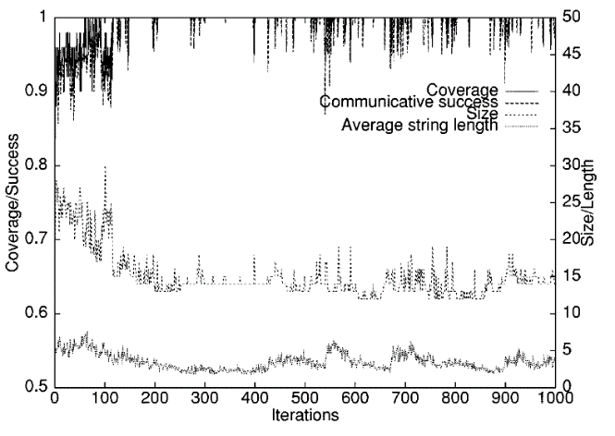
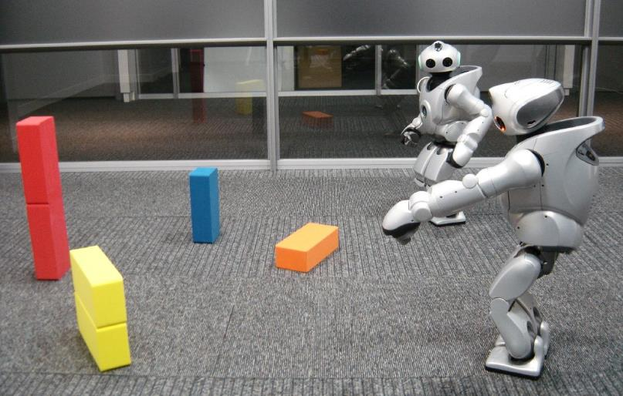
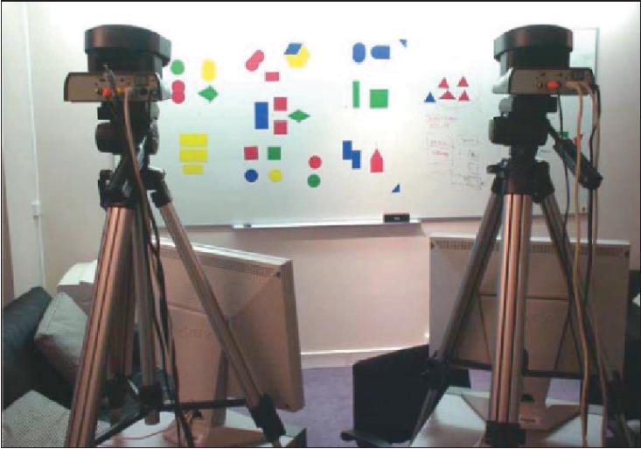
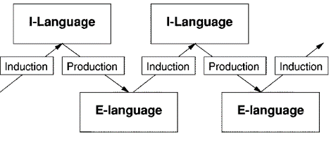

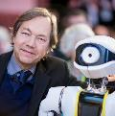
Cultural evolution of language: Simulations/models
Kirby 2001 IEEE Trans Evol Comp
Kirby 2017 Psychon Bull Rev
Steels 1998 Artificial Intelligence
Steels 2015 The Talking Heads Experiments. Lang Sci Press

Slide 16
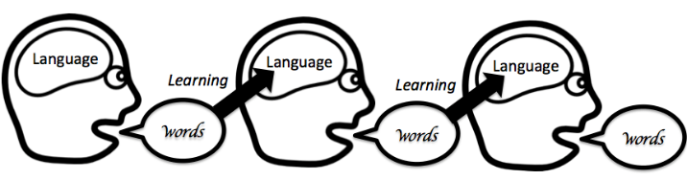
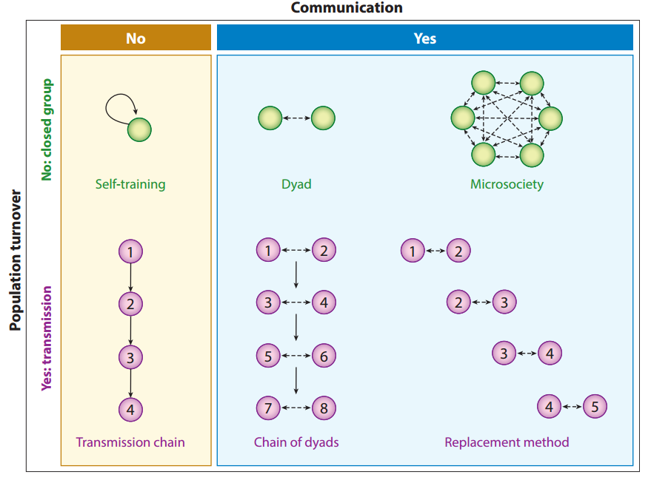
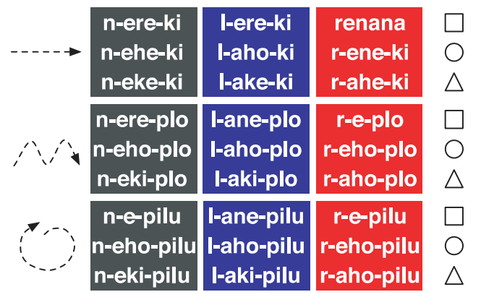
Cultural evolution of language: experiments
Kirby et al. 2008 PNAS
Galantucci 2005 Cogn Sci
Garrod et al. 2007 Cogn Sci
Tamariz 2017 Annu Rev Linguist

Slide 17
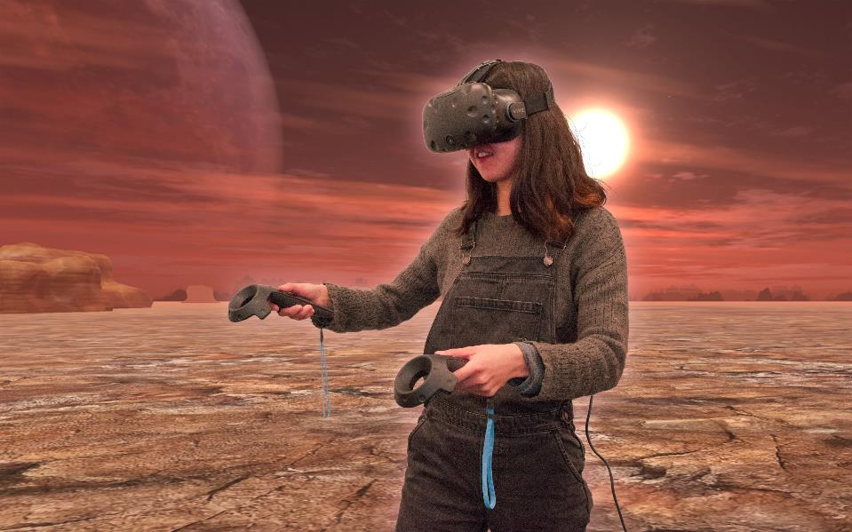
Cultural evolution of language: experiments
Nölle et al., in progress

Slide 18


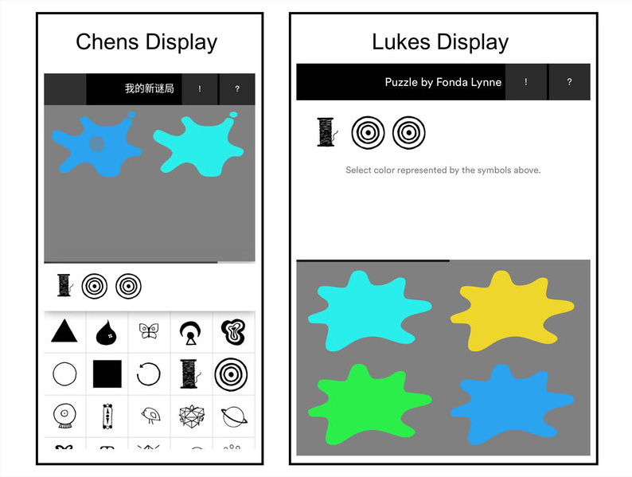

Cultural evolution of language: experiments
Morin et al. 2018 JoLE

Slide 19
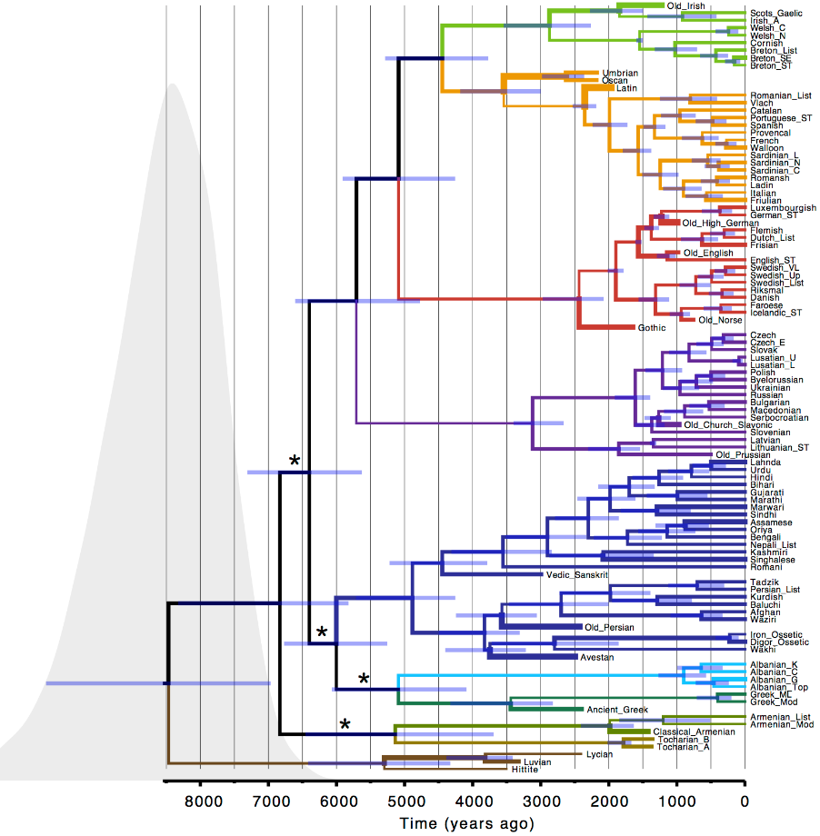
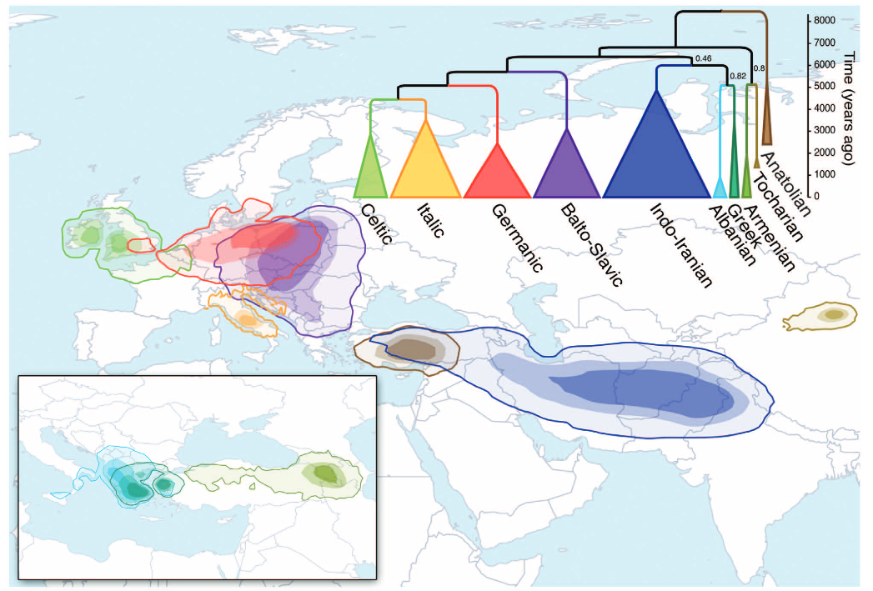
Phylogenetic trees
Bouckaert et al. 2012 Science
Notes:
now as far as real languages are concerned… Bayesian phylogeography to assess the origin of the IE lang fam

Slide 20
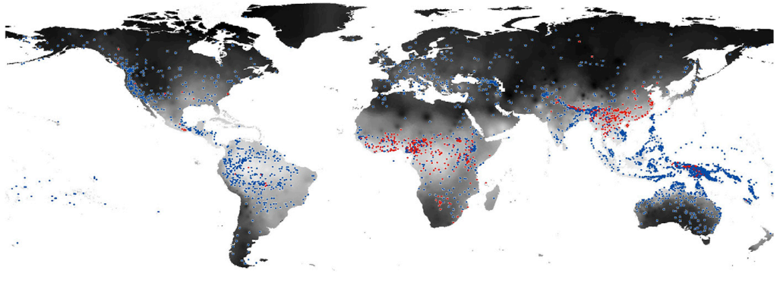
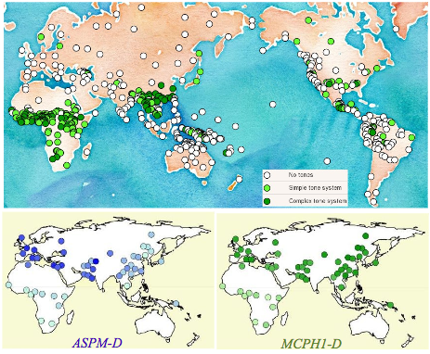

Language × environment
Everett, Blasi & Roberts 2015 PNAS
Dediu & Ladd 2007 PNAS
Notes:
large-scale studies looking at language and nonlinguistic variables, such as climate
it’s now pretty accepted that languages don’t evolve independently of social, technological and physical environment (L&D)
What is the causal relationship between individual constituents of language (sounds, words, idioms, ... - see Enfield 2014)
Which causal factors give rise to (specific traits of) language structure?

Slide 21


Language × environment
Causality?
Lupyan & Dale 2010 PLOS ONE
Notes:
large-scale studies looking at language and nonlinguistic variables, such as climate
it’s now pretty accepted that languages don’t evolve independently of social, technological and physical environment (L&D)

Slide 22


Language × environment
CHIELD
chield.excd.org
Ardell et al. (2016); Atkinson et al. (2016); Bentz and Berdicevskis (2016); Bentz and Winter (2013); Lupyan and Dale (2010); Cuskley and Loreto (2016); Atkinson et al. (2016)
Roberts 2018 Evolang
Notes:
large-scale studies looking at language and nonlinguistic variables, such as climate
it’s now pretty accepted that languages don’t evolve independently of social, technological and physical environment (L&D)

Slide 23
Workshop program

Slide 24
Workshop program: General information
Topics
Experimental/Behavioural | Language Dynamics & Change
Origins of Language | Evolution of Semantics
Large-scale Patterns & Extralinguistic Influences
Cancellations
Andreas Baumann & Nikolaus Ritt | On the relative impact of extra-linguistic correlates in linguistic evolution: a systematic sensitivity analysis of variables associated with population size
Sverker Johansson | Clues to language evolution from a massive dataset with typology, phonology, and vocabulary from many languages
Michael Collins | The Co-Evolution of Language and Object-Throwing

Slide 25
Workshop program: General information
Topics
Experimental/Behavioural | Language Dynamics & Change
Origins of Language | Evolution of Semantics
Large-scale Patterns & Extralinguistic Influences
Additional Talk! Sa, 9.30 Room 5
Ezequiel Koile, Simon J. Greenhill, Tom Güldemann, Remco Bouckaert and Russell D. Gray | Bantu Expansion: A phylogeographic study

Slide 26



Workshop program: Thursday
Experimental
14.30 - 14.55 | Jennifer Culbertson | Noun phrase word order across languages reflects simplicity and naturalness
15.00 - 15.25 | Gareth Roberts | Why sociolinguistics and language evolution should talk more
15.30 - 16.00 | Coffee Break
16.00 - 16.25 | Russel Gray, Adam Powell, Cosimo Posth, Annemarie Verkerk & Mary Walworth | Waves of history and layers of evidence: what can the combination of linguistics and genetics tell us about the nature, timing and impact of Papuan contact on the Austronesian languages of Vanuatu?
16.30 - 16.55 | Niklas Johansson | Triangulating sound symbolism: where to find it and how to create it
19.00 | Joint WS dinner | Café Must Puudel, Googleform (see email!) Meet at 18.40 at ASTRA entrance
Patterns & Extraling.
Notes:
the green pattern block is more

Slide 27

Workshop program: Friday (morning)
9.00 - 9.25 | Simon Greenhill, Lindell Bromham, Marcel Cardillo, Hilde Schneemann & Xia Hu | Testing the complex relationship between language diversity, biodiversity, and ecology
9.30 - 9.55 | Cristina Guardiano & Giuseppe Longobardi | Syntactic theory and human diversity
10.00 - 10.55 | Plenary | (Maria Koptjevskaja-Tamm, Stockholm)
11.00 - 11.30 | Coffee Break
11.30 - 11.55 | Gerhard Jaeger | Typologies in equilibrium
12.00 - 12.25 | Andres Karjus, Richard A. Blythe, Simon Kirby & Kenny Smith | Two problems and solutions in evolutionary corpus- based language dynamics research
12.30 - 12.55 | Borja Herce | Language evolution in the absence of functional pressures
Patterns & Extraling.
Dynamics & Change
Notes:
note that after the first two talks there‘s a longer break (plenary and coffee break)

Slide 28


Workshop program: Friday (afternoon)
13.00 - 14.00 | Lunch Break
14.00 - 14.25 | Dariusz Kalociński | Scalar language under communicative pressure: road to “most”
14.30 - 14.55 | Fausto Carcassi, Marieke Schouwstra & Simon Kirby | The Evolution of Scalar Terms' Semantic Structure
15.00 - 15.25 | Ariel Cohen | A Natural Prehistory of Negation
15.30 - 16.00 | Coffee Break
16.00 - 16.25 | Bridget Samuels, Pedro T. Martins, Tom O'Rourke, Alejandro Muñoz, Saleh Alamri, Constantina Theofanopoulou & Cedric Boeckx | Rethinking neoteny and neuroplasticity in language evolution
16.30 - 16.55 | Discussion
Evol. of Semantics
Origins

Slide 29
Questions

Slide 30
Example questions for discussion
What are the limits of language evolution research?
What promising new directions are missing from this workshop?
Are we in fact "coming of age"? Does language evolution research in the near future look different from 5 years ago?
How should we approach new frontiers? Large interdisciplinary groups? Many small projects?

Slide 31

Keynote Jennifer Culbertson Noun phrase word order across languages reflects simplicity and naturalness
Notes:
BA Ling from Brown U., MA and PhD in Cognitive Science
Her PhD dissertation titled “Learning biases, regularization, and the emergence of typological universals in syntax” was awarded with the Glushko dissertation prize of the Cog Sci Soc in 2010
after a postdoc in Rochester and appointments at George Mason and Jon Hopkins University she finally moved to Edinburgh in 2014, where she is now a reader at the centre for language evolution
Her main interest lies in explaining how linguistic structure, or more specifically typological universals result from cognitive processes and biases, which she addresses empirically with artificial language experiments and models
Currently, she is exploring this question in two projects funded by the ERC and ESRC that explore how universals in syntax are shaped by cognitive biases

